Slide 1

ARTIFACT OOP Project
Thai Thanh Phat ITITIU21274
Game mechanic, Gameloop, Collision, Debugger, Git, Utilz
Vo Hoai Bao ITITIU21038
GUI, Sound, UML, Maps, Utilz, Gamestates
Truong Dinh Toan
ITITIU21332
Inputs, Entities, Utilz
Nguyen Duc Duy ITITIU21008
Objects, Levels, Utilz
Welcome to our final project

Slide 2
01
Group members & Task allocation
02
Story
Introduction
TRAN VIET TRUNG
ITITWE22116
HO NGOC AN ITITIU21146
UML, Gameloop, Debugger, Git, Utilz
GUI, Sound, UML, Maps, Utilz, Gamestates
04
03
Tutorial
Design & New features
LE BA KHANH HOANG ITITWE22134
06
UML - Diagram
05
Objects, Levels, Utilz
4 Properties of OOP

Slide 3
TABLE OF CONTENTS
01
Introduction
02
Story
03
Tutorial
04
Design & New features
05
06
UML - Diagram
4 Properties of OOP

Slide 4
Introduction
01
This is our object-oriented programming game project at HCMIU in semester 2 (2022-2023).
It's a classic platform game where the hero battles monsters and faces traps while on a quest to defeat the dark knight.

Slide 5



ARTIFACT
"Artifact, a Java-based 2D platformer showcasing engaging gameplay, dynamic mechanics, and creative level design. Built with Java, Git, and GitHub for version control and collaboration."
THE STORY

Slide 6


THE STORY
02

Slide 7
THE STORY
Artifact: a thrilling quest game.
Goal: become a legendary Hero and defeat the dark knight.
3 levels, pixel art, retro music.
Challenges: monsters and traps.
Technology: JAVA on IntelliJ IDEA.

Slide 8
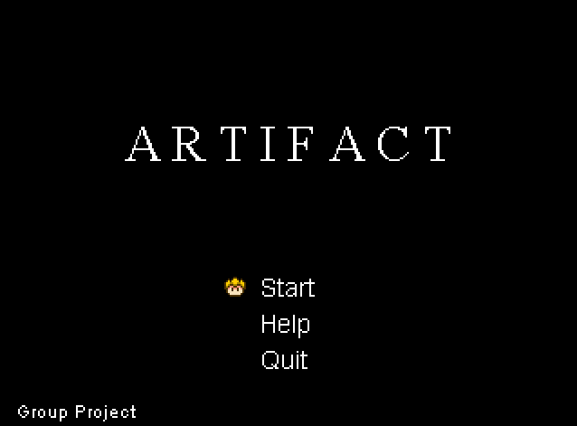

03. HOW TO PLAY
“Play” to start the game.
“Help” for knowledge about how to play game.
“Quit” to close the game.

Slide 9
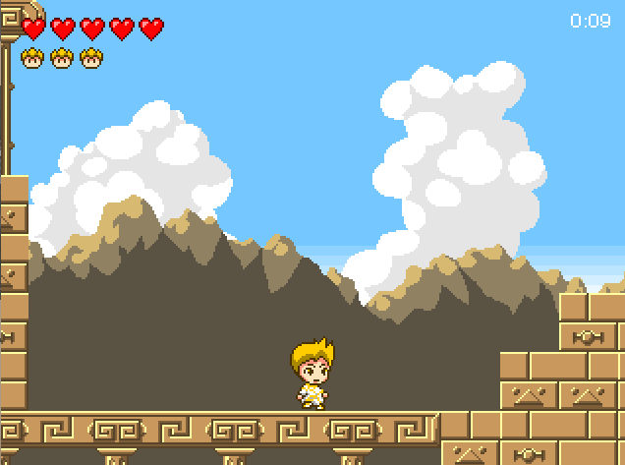
03. HOW TO PLAY
Move: →, ←.
Attack: R.
Jump: W.
Dash: F.
Defeat all the enemies and you will pass the level.

Slide 10
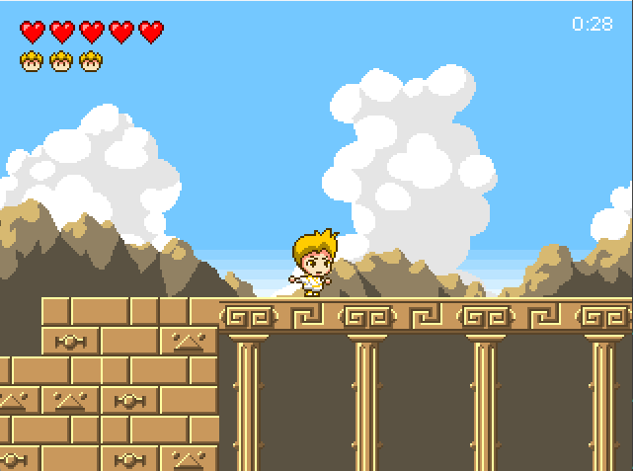
03. HOW TO PLAY
Hold E and the button →,← to run.

Slide 11
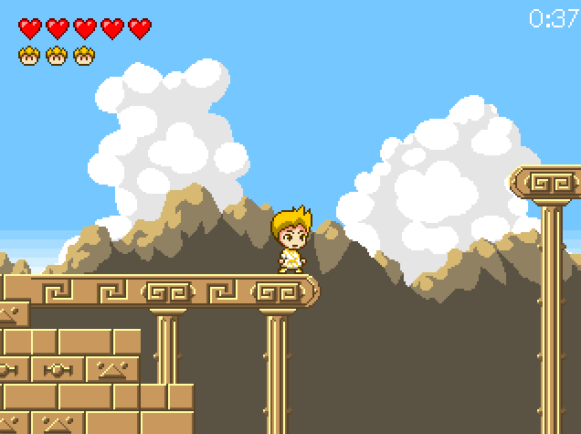
03. HOW TO PLAY
Fall into a abyss the game will start over

Slide 12
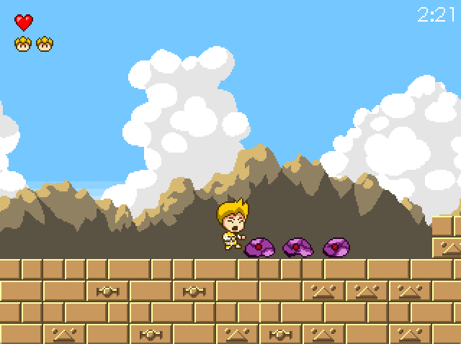
03. HOW TO PLAY
If you get hit by monster in this game, you will lose HP.

Slide 13
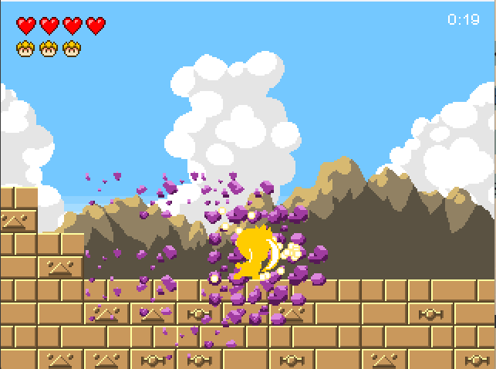
03. HOW TO PLAY
You can kill all enemies by F in a straight line when using dash

Slide 14
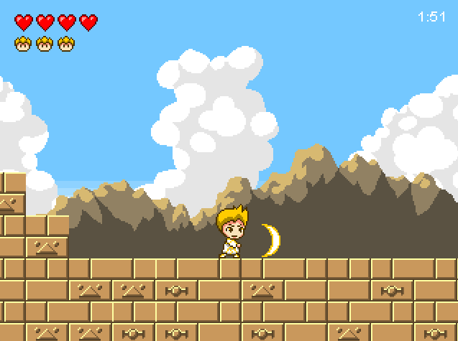
03. HOW TO PLAY
Use ulti R, the enemy will die.

Slide 15
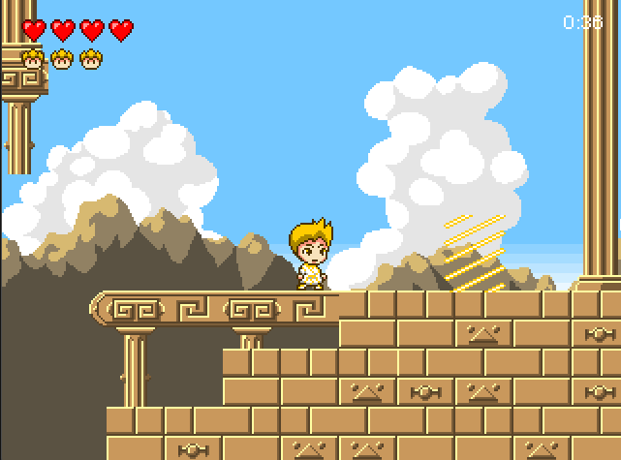
03. HOW TO PLAY
The place to move to the next stage.

Slide 16
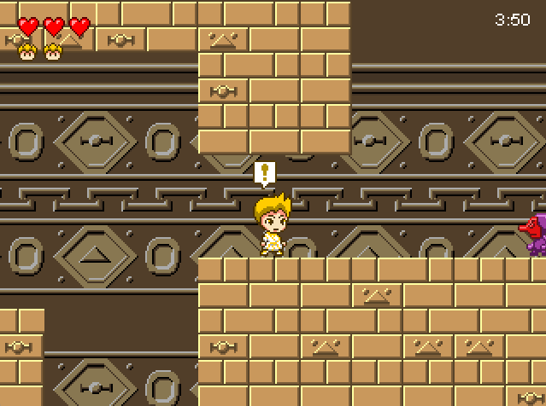
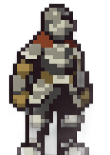
03. HOW TO PLAY
This is a sign that you are near the BOSS.

Slide 17
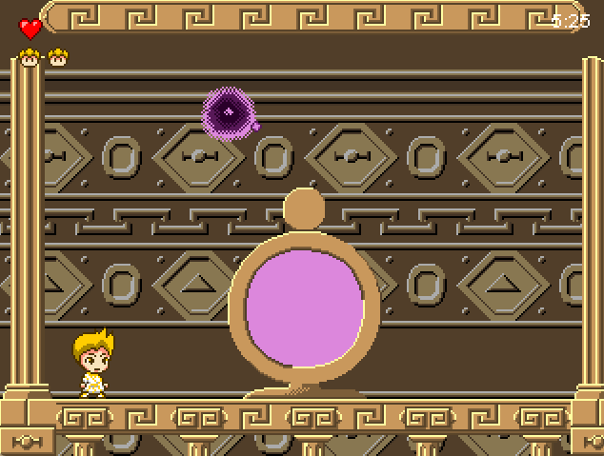
03. HOW TO PLAY
You need to kill the BOSS to win this game.

Slide 18
03. HOW TO PLAY
*Hint: Fight the boss with F.
Using R with ↑ will control the skill to damage the boss.

Slide 19
04. Design & New features
BufferedImage for image files and pixel color manipulation.
Pixel colors for game components with RGB channels.
Level class for level data and game elements.
Google resources for optimization.

Slide 20
04. Design & New features
Keyboard control for movement and attack.
Slashing move until hitting tiles.
Tutorial at the start.
Bosses at the end.
Jumping costs energy.
.

Slide 21
04. Design & New features
Polymorphism
Inheritance
State pattern for modes and transitions in gamestates package.
Constants class for game constants.
Single Responsibilities pattern applied.
Design principle for readability and maintainability.
Abstraction
Encapsulation

Slide 22

05. 4 properties of OOP
Encapsulation
Abstraction
03
04
01
02
Inheritance
Polymorphism
Encapsulation in our game project using classes like Player, Enemy, and Game
For example, the Player class has specific attributes
Attributes and methods are hidden.
Getters and setters

Slide 23

a) Encapsulation
- We used abstraction and interfaces to capture shared characteristics among game objects.
- Abstract classes like Enemy encapsulated common functionality for all enemies, promoting code reuse.
03
01
01
02
03
04
- The StateMethod interface guarantees consistent behavior across various game states.
- Abstraction improved modularity and maintainability, facilitating efficient representation of shared features and streamlined development.
02
04
Encapsulation in our game project using classes like Player, Enemy, and Game.
Attributes and methods are hidden.
For example, the Player class has specific attributes.
Getters and setters.

Slide 24
b) Abstraction
Abstraction and interfaces define common behaviors for game objects.
Enemy class.
01
03
Reducing code duplication. Promoting modular code.
Create subclasses for code reuse and hierarchy.
Abstraction enhanced modularity and maintainability of shared features.
02
The GameState interface.
04
For example, GameObject and Entity

Slide 25
c) Inheritance
Create subclasses for code reuse and hierarchy.
Reducing code duplication. Promoting modular code.
For example, MapObject and GameState

Slide 26
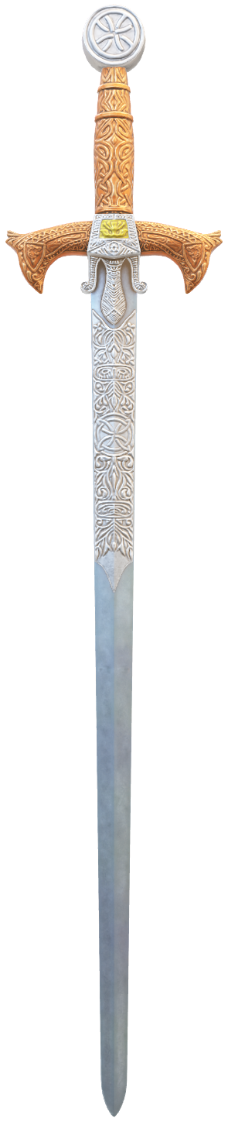
d) polymorphism
Utilz
Audio
Levels
The AcidState class contains GameState methods.
Depend on the type of collision.
Entities
Main
Game states
Objects
Do you have any questions?
Inputs
GUI
THANK YOU FOR YOUR LISTENING

Slide 27
SOLID IN OOP
1 - Single responsibility principle
2 - Open/closed principle
3 - Liskov substitution principle
4 - Interface segregation principle
5 - Dependency inversion principle

Slide 28

1 - Single responsibility principle:
Each class should have only one responsibility.
Multiple responsibilities make a class harder to manage, test, and extend.

Slide 29
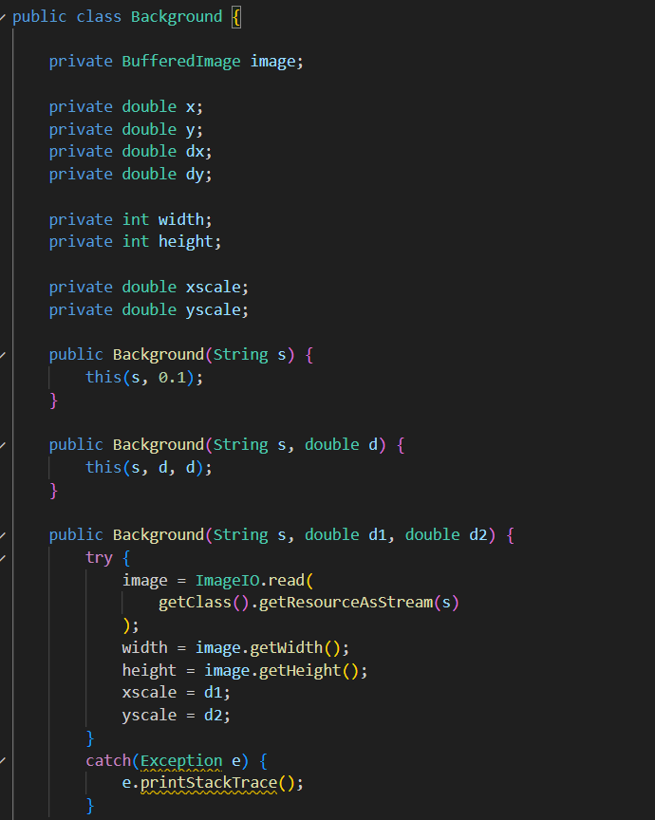
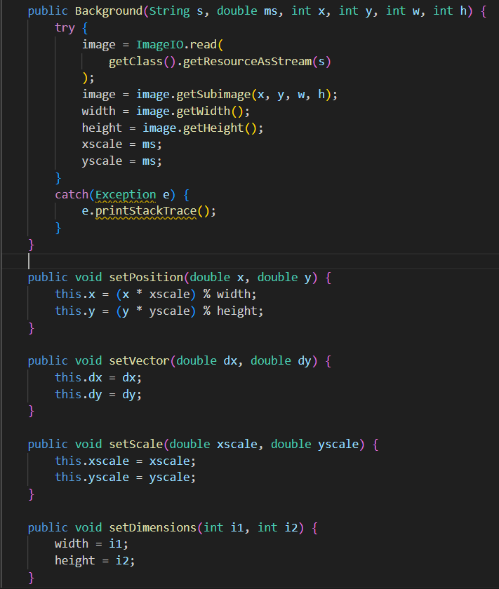
Example:

Slide 30
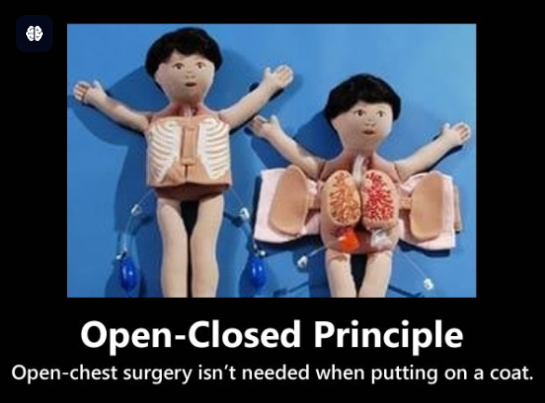
2 - Open/closed principle:
The Open/Closed Principle (OCP) ensures software can be extended with new features without altering existing code, enhancing stability and reducing errors.

Slide 31
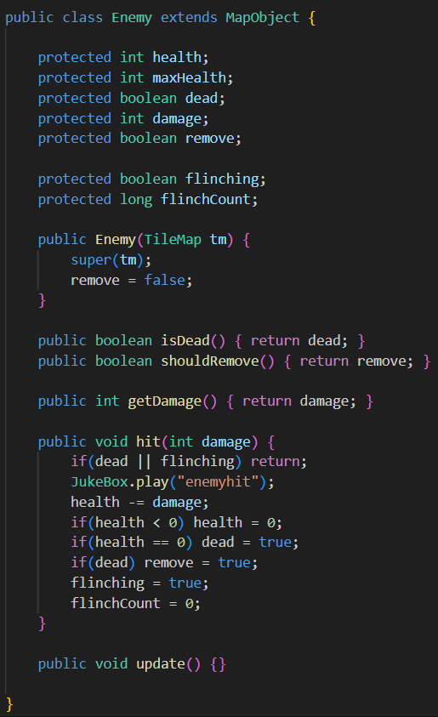
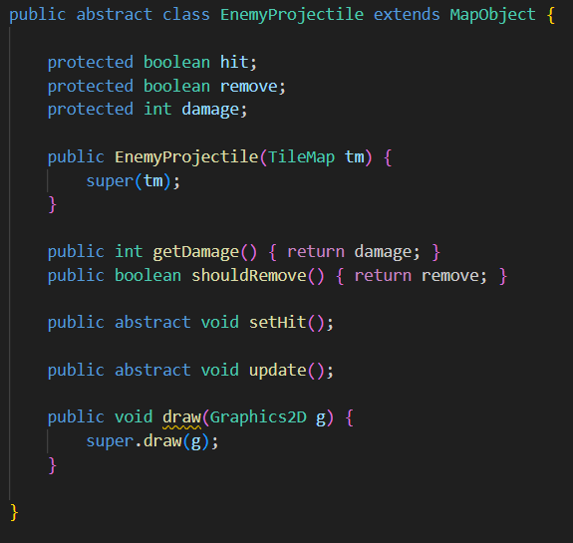
Example:

Slide 32
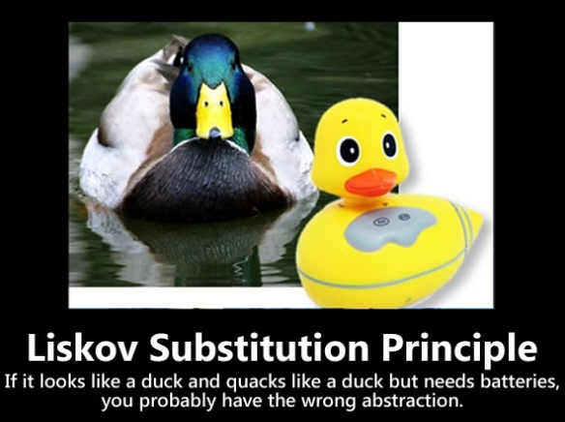
3 - Liskov Substitution Principle:
Subclass objects should replace superclass objects without affecting program correctness.

Slide 33
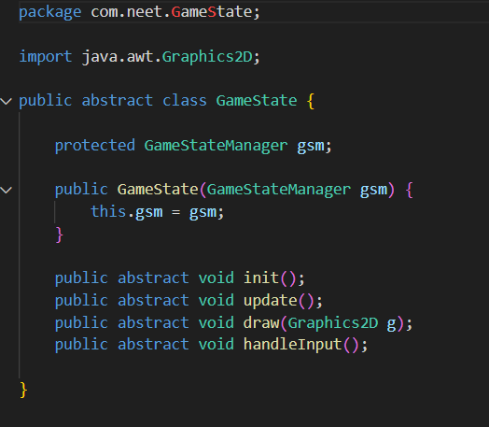
Example:

Slide 34
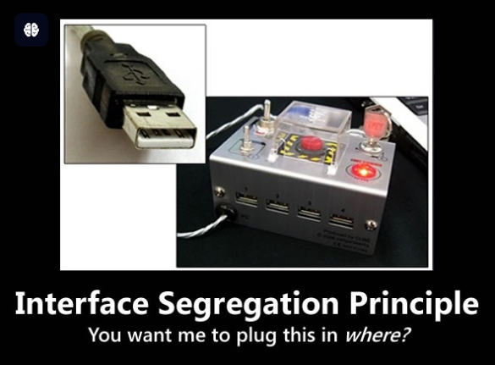
4 - Interface Segregation Principle:
- The Interface Segregation Principle (ISP) ensures classes only implement methods they need by breaking large interfaces into smaller, task-specific ones.

Slide 35
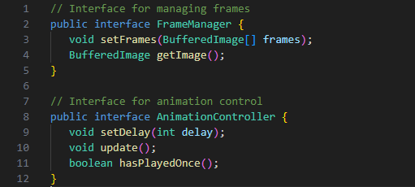
Example:
The Animation class can then implement these interfaces if needed.

Slide 36

5 - Dependency Inversion Principle (DIP)
- The Dependency Inversion Principle (DIP) reduces coupling between high-level and low-level modules by relying on abstractions like interfaces or abstract classes instead of concrete implementations.

Slide 37
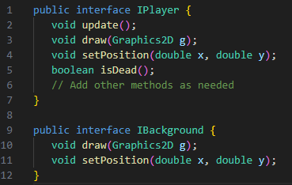
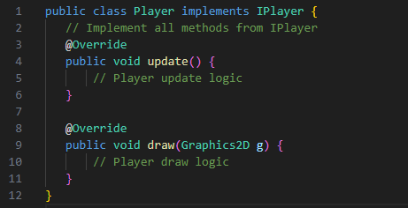
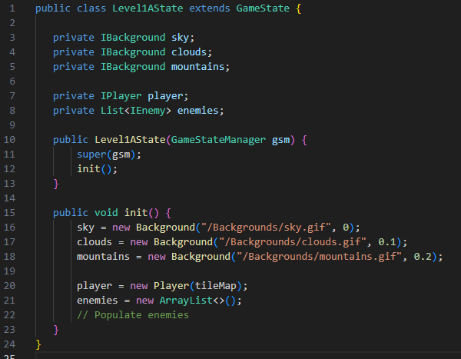
Define interfaces for key components such as Player, Enemy, Background, etc.
Let concrete classes like Player and Background implement these interfaces.
Refactor Level1AState to depend on interfaces rather than concrete implementations.

Slide 38
Benefits of Refactoring for DIP:
Flexibility: You can easily swap out implementations (e.g., a different Player class) without modifying Level1AState.
Testability: Mock objects or stubs can replace actual implementations in tests.
Scalability: Adding new types of Player or Enemy is easier and does not affect the Level1AState code.

Slide 39
Audio
UML - DIAGRAM
Entities
Game states
Levels
Main
Objects
Do you have any questions?
THANK YOU FOR YOUR LISTENING

Slide 40
THANK YOU FOR YOUR LISTENING
Do you have any questions?

